Slide 1

GREEN DESTINATION EMPLOYEE ATTRITION PROJECT

Slide 2
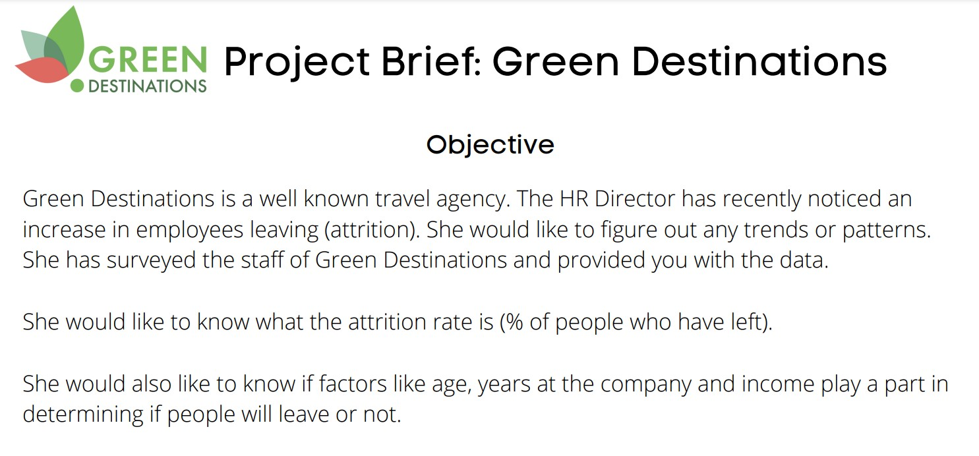

Slide 3
The aim of this project is to analyze an employee data set containing data regarding employees leaving their jobs and other important employee data.
Finding patterns in the data to get an insight into the various factors affecting the employee attrition(Quitting the job).

Slide 4
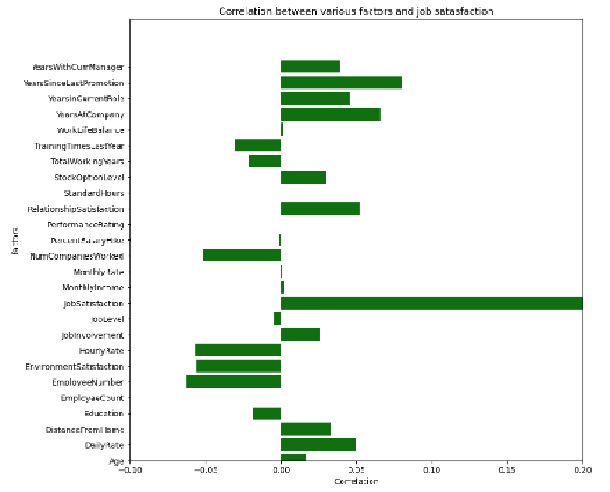
From the correlation plot it's seen that jobsatisfaction is affected by various factors.
Factors like YearsSinceLastPromotion,
YearsAtCompany and DailyRate have a strong influence on jobsatisfaction

Slide 5
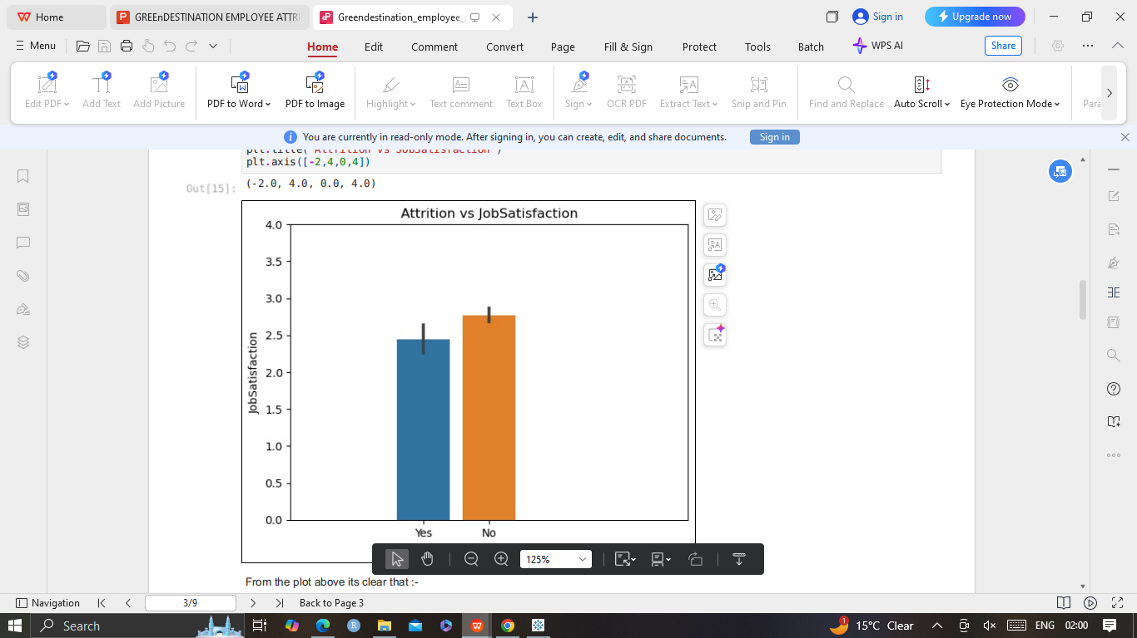
Relation between Attrition and job satisfaction
The average jobsatisfaction score of employees quitting their jobs is lower than those not leaving their jobs.
It can be concluded hence that jobsatisfaction is an important factor in employees leaving jobs.

Slide 6
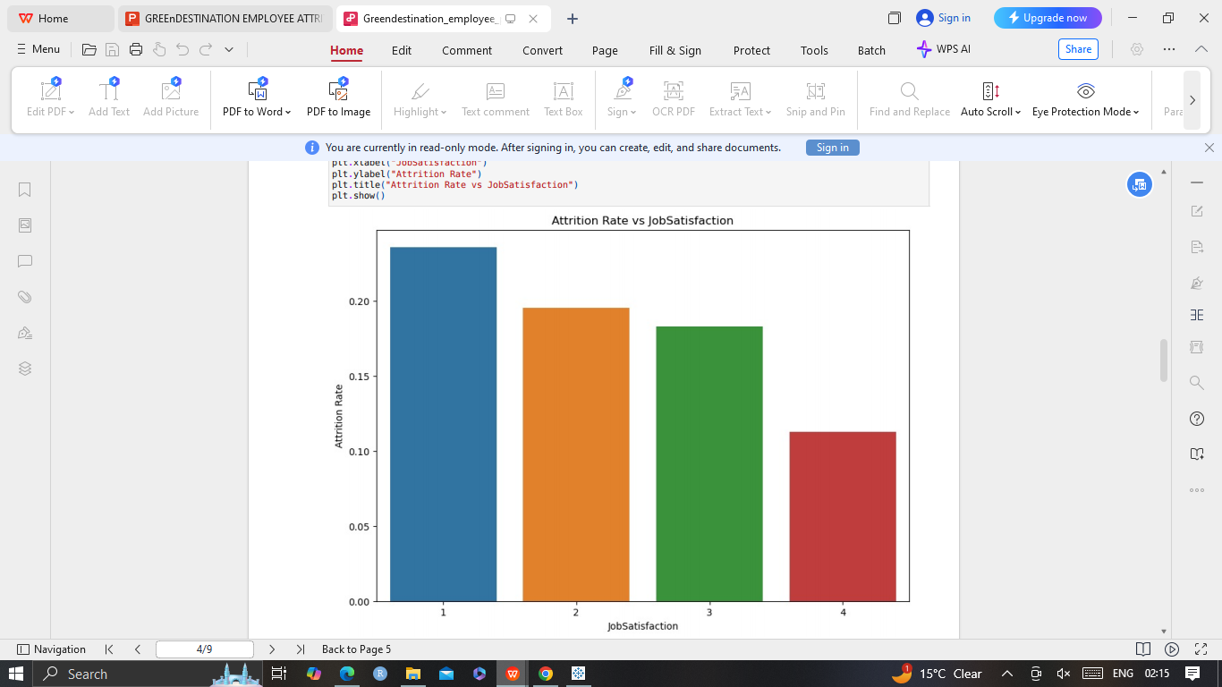
Attrition vs Jobsatisfaction
At higher jobsatisfaction levels the attrition rate is significantly lower
An employee with jobsatisfaction score of 1 is twice more likely to quit his job compared to an employee with a score of 4

Slide 7
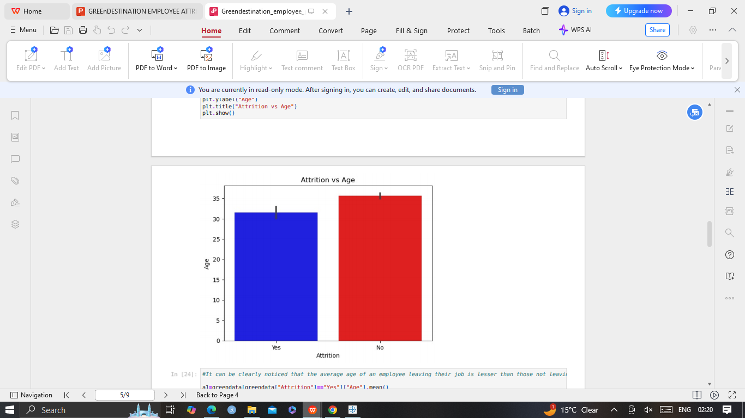
Attrition vs age
Average age of an employee leaving their job is 31 and the average age of an employee not leaving their job is 35.
Hence a younger employee is more likely to quit their job than an older employee

Slide 8
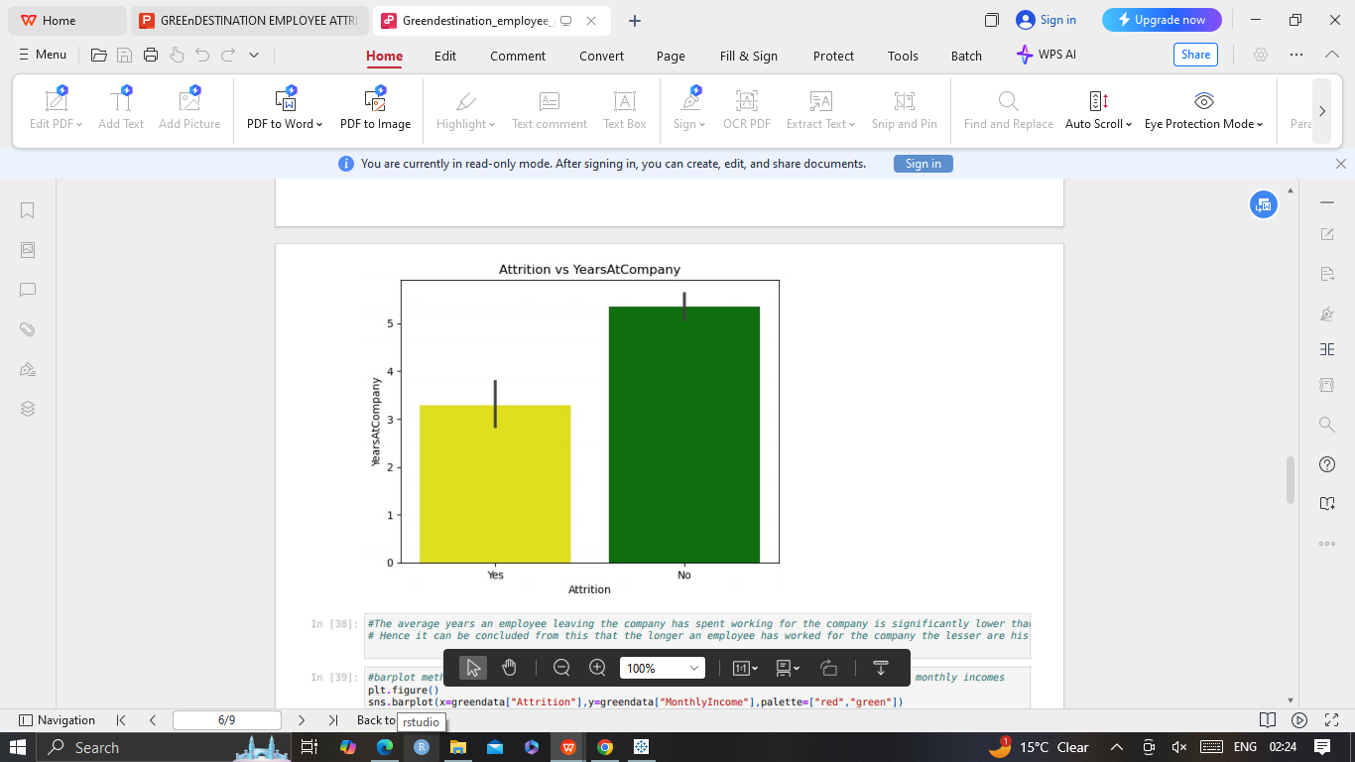
Attrition vs yearsat company
The average years an employee leaving the company has spent working for the company(≈ 3.5 years) is lower than those staying(≈5 Years).
Hence the longer an employee has worked for the company the lesser are his chances of quitting

Slide 9
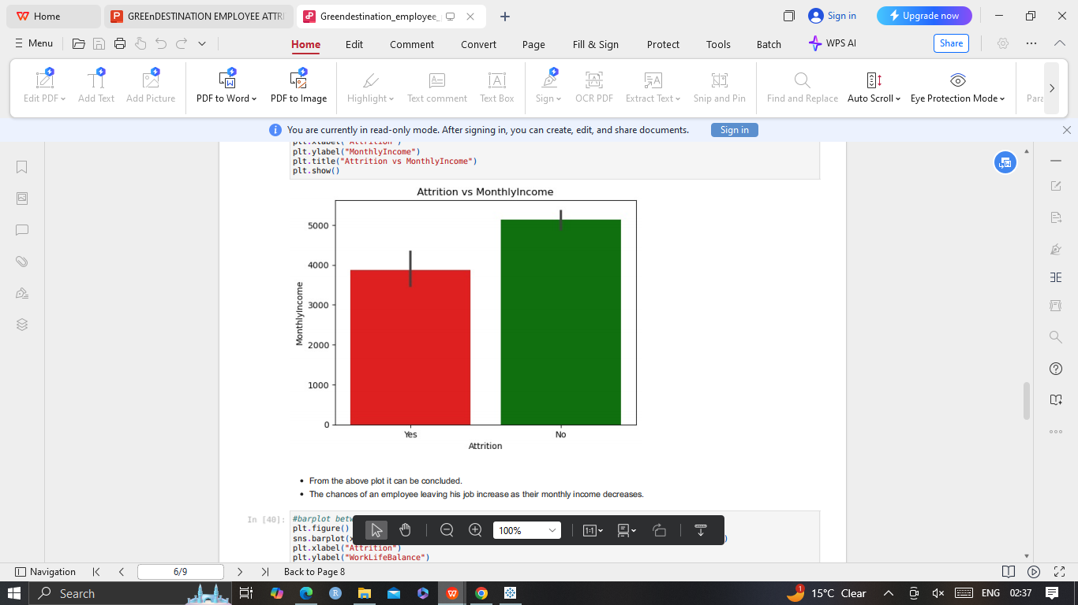
Attrition vs monthly income
The average monthly income of an employee leaving the company (≈ 3800) is lower than those staying(≈5000).
The chances of an employee leaving his job increase as their monthly income decreases.

Slide 10
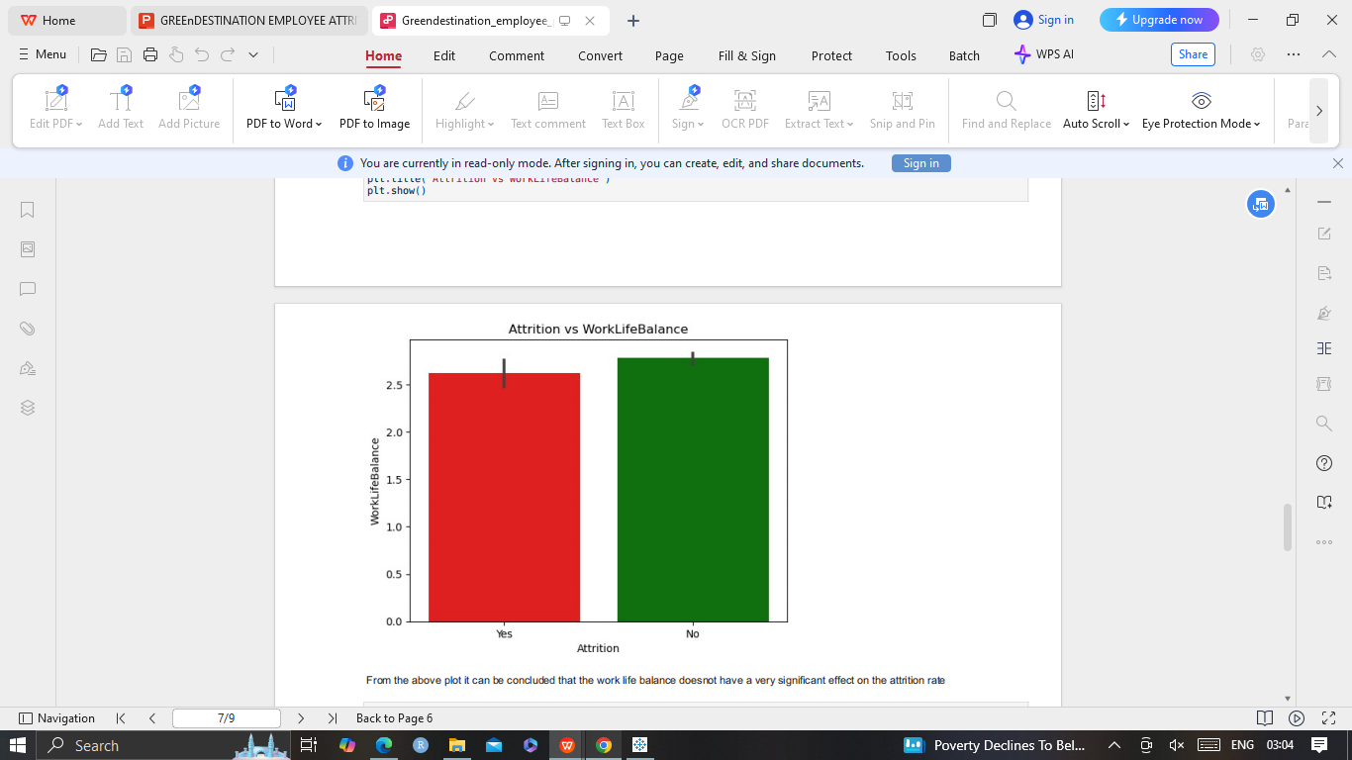
Attrition vs Work life balance
From the figure it can be concluded that the work life balance does not have a very significant effect on the attrition

Slide 11
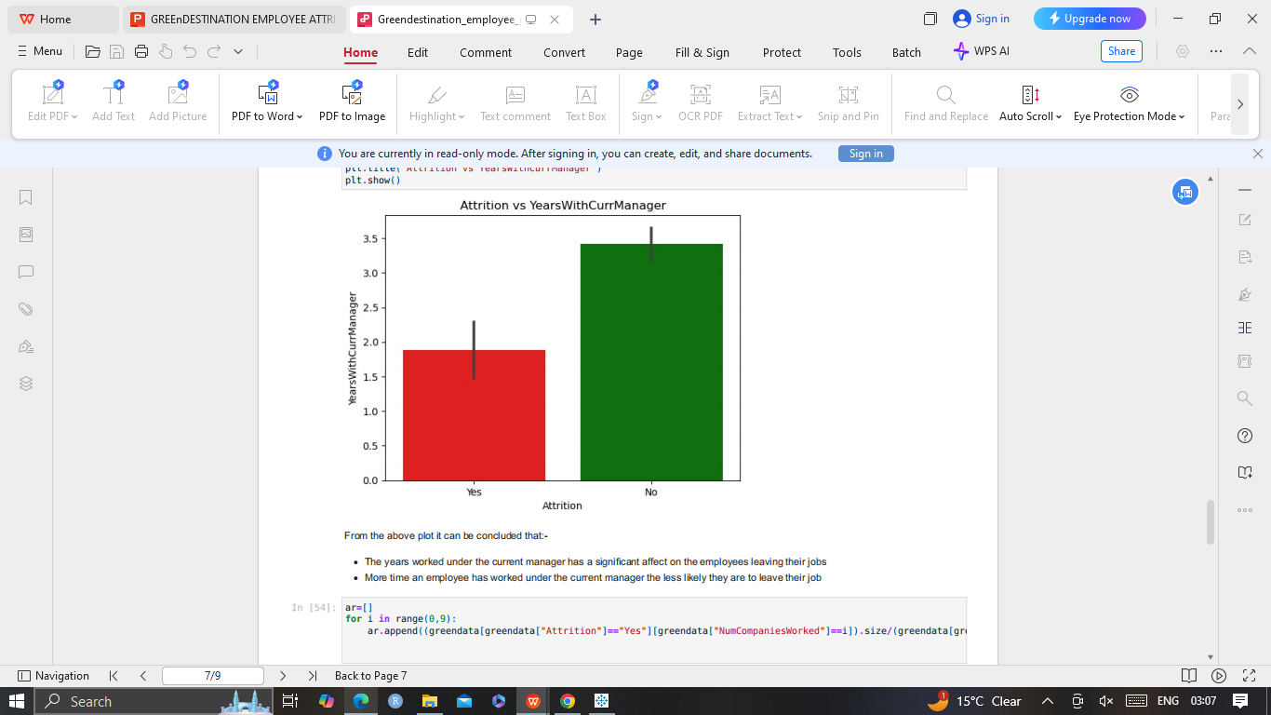
Attrition vs years with current manager
The years worked under the current manager has a significant affect on attrition.
More time an employee has worked under the current manager the less likely they are to leave their job

Slide 12
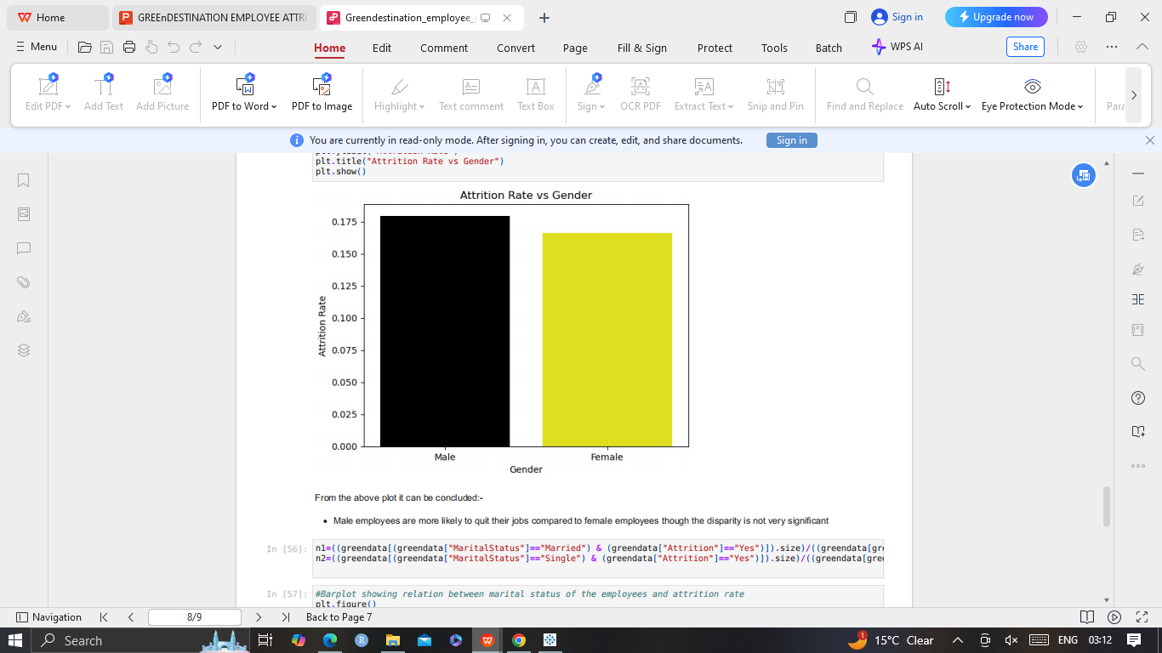
Attrition vs gender
Male employees are more likely to quit their jobs compared to female employees though the disparity is not very significant

Slide 13
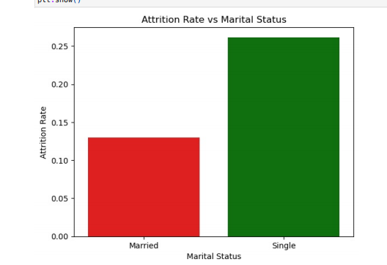
Attrition vs marital status
Unmarried or single employees have a ≈26% chance of quitting their jobs.
Married or single employees have a ≈14% chance of quitting their jobs

Slide 14
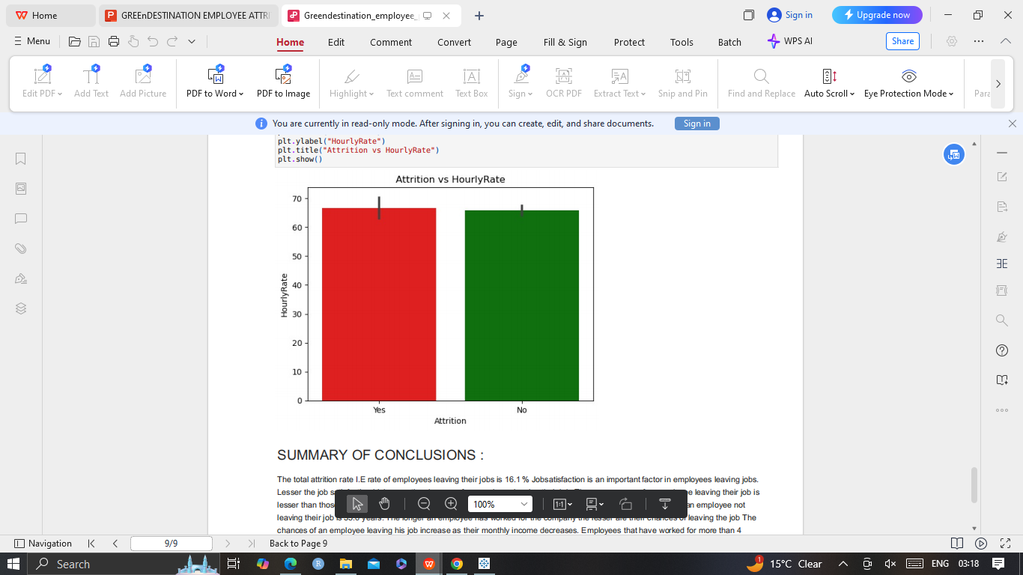
Attrition vs Hourlyrate
From the following plot it can be seen that the hourly rate doesnt have a significant effect on the attrition at all

Slide 15
Conclusions
Jobsatisfaction is an important factor in employees leaving jobs
The total attrition rate I.E rate of employees leaving their jobs is 16.1 %
Lesser the job satisfaction higher are the chances of an employee leaving their job
Average age of an employee leaving their job is 31.5 years and average age of an employee not leaving their job is 35.6 years
The longer an employee has worked for the company the lesser are their chances of leaving the job
The chances of an employee leaving his job increase as their monthly income decreases.
More time an employee has worked under the current manager the less likely they are to leave their job.
Employees that have worked for more than 4 companies prior to the current job are more likely to leave their jobs.
Amongst all experience levels fresher's are the least likely to leave their jobs.
Male employees are more likely to quit their jobs compared to female employees though the disparity is not very significant.
Unmarried or single employees have a significantly higher chance of quitting their jobs than their married colleagues.
Hourly, monthly and daily rate don't have a significant affect on the attrition at all

Slide 16
